Slide 1
Automation Report
Automation Task Progress
Issue & Request
2020.11.02
VS DCV

Slide 2
Automation Team Task
Automation Task Progress
Role | Goal | Detailed action items | Target
Expand automation test | Expand Automation Test Coverage & Reliable Test Script (Gen11 TCP GB) | 1. Increase coverage of automation test | 35%
 |  | 2. Increase reliability of test scripts: (Reliability: Ratio TSs matching manual TCs/Total TSs) | 61%
Keep developing Automation tools for work efficiency | - Improve execute test productivity - Save time for automatable activities - Support leaders in summary and monitoring project | 1. Auto download tool | 06/01
 |  | 2. Comparison tool for ADA | 07/03
 |  | 3. VTM Location data extraction | 07/24
 |  | 4. Collision data calculator | 07/31
 |  | 5. ALDL DV check | 08/10
 |  | 6. Analyse Error code | 10/19
 |  | 7. Support management tasks | 11/30
Issue and request
- Gen 11 TCP GB: Many TCs cannot because of the command library limitation → Shared needed command library to HQ.
- DCV take automation for Telematics GM Gen11 TCP GB only → Request expanding for other projects in 2021
1 / 1

Slide 3
Thank you

Slide 4
Expand Automation Test Coverage & Reliable Test Script
Y20 Summary
R&R | Y19 | Y20 Target | Y20 Actual | Sub action
Increase Automation coverage | 18.6% | 35 % | 30% | Create new test scripts based on automatable TCs
 |  |  |  | Increase common library
 | 2019 | 2020
 |  | Mar | Apr | May | Jun | Jul | Aug | Sep | Oct | Nov | Dec
Overall Schedule
MY21
MY23 v5.02
MY23 v5.05
MY23 v5.13
Coverage: 18.6%
Reliability: 100%
Successful rate: 52%
Coverage: 34%
Reliability: 100%
Successful rate: 52%
Coverage: 30%
Reliability: 100%
Successful rate: 90%
Coverage: 40%
Reliability: 100%
Successful rate: 97%
Apply automation for full validation
Automation coverage
Issue and action plan
No | Description | Action plan | PIC
1 | Sampling compare data with manual result for module (except TNS and CR module) | Manual team selects test cases need to sampling Get result and compare manual result | Phuong Pham Duy Ngo
2 | 532 new Test scripts still have not be checked reliability | Run manual TCs to get result base line for new scripts Debug and update scripts | Duy Ngo Dan Nguyen
3 | TCs behaviour changed due to spec changed | Update script following the latest confirmation
4 | Log file content changed from v5.13. (relating to check inexistent log in log file) | Suggest HQ support to add more common library
A. 1 / 10

Slide 5

Keep developing Automation tools for work efficiency: Automatic download system
Summary
Purpose | Concept | Out put | Effectiveness
 |  |  | Frequency | Manual time | Automation time | Remark
Automatic download SW | Check the exist the latest SW Download SW automatically when SW released on server | Shell script | 2 times/week | 3h | 3h | Save time if SW is release at night
BEGIN
Manual
Automatically
Check latest software on Website
Download software manually and save Image at IT PC
Download software automatically and save software at IT PC
Software Exist on PC
Y
N
Copy software from IT PC to USB
Copy software from IT PC to USB
Start download
Continue download
N
Download successfully
Flashing
Flashing
Y
END
A. 2 / 10

Slide 6
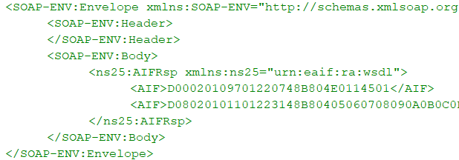
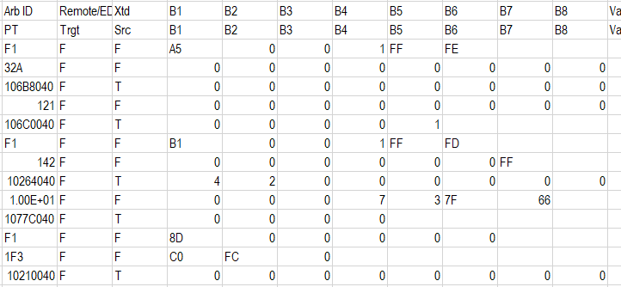

Keep developing Automation tools for work efficiency: Comparison tool for ADA
Summary
Purpose | Concept | Output | Effectiveness
 |  |  | Frequency | Manual time | Automation time | Remark
Comparison tool for ADA | Compare log file (VTM log, ADA log, CAN log) automatically (about hundreds of log lines) | VBA script | Full validation phase | 30 minutes | 5 minutes | - Reduce human mistakes - Decrease comparing time on testing incase have a lot of ECUs
OCC
Check ADA Response from OCC (1)
OCC Log
Collect data from CAN log
+
ADA Data comparison tool
Target sample
Build up OCC response from CAN log (2)
CAN Simulator
CAN Log
Compare (1) and (2)
END
A. 3 / 10

Slide 7
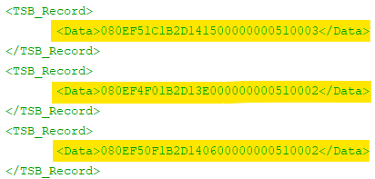
Keep developing Automation tools for work efficiency: VTM Location data extraction
Summary
Purpose | Concept |  | Effectiveness
 |  | Outcome | Frequency | Manual time | Automation time | Effectiveness
Get VTM location data on OCC | Extract and calculate all location data from VTM log | VBA script | When have release | 3 mimutes/TC | 30 seconds/TC | - Reduce calculator time (Request from OEM)
OCC
(2) TCP Response Location Data
Analyse response messages
(1) Request to read location data
(1)
(2)
Convert hexa to decimal
Calculate to actual value
Target board
A. 4 / 10

Slide 8
Keep developing Automation tools for work efficiency: Collision data calculator
Summary
Target | Concept | Out put | Effectiveness
 |  |  | Frequency | Manual time | Automation time | Remark
Collision data calculator | Calculate collision Data (27 Bytes) from input signals (8 Bytes) based on priority and mapping table | VBA script | When do collision exploratory test, write TCs, TSs | 5 minutes/TC | 1 minute/TC | - Reduce calculation time
OCC
Trigger collisions
Target board
Calculate Collision Data and send to OCC:
+ Length: 27 Bytes
+ Store set data of 3 collision events
+ Based on priority, mapping table between Collision signals and Collision Data → Collision Data is calculated automatically when have any collision signal comes.
CAN
Simulator
Collision signal 1 (8 Bytes)
Collision signal 2 (8 Bytes)
...........
Calculate Collision Data
Collision signal n (8 Bytes)
A. 5 / 10

Slide 9
Keep developing Automation tools for work efficiency: ALDL DV check
Summary
Purpose | Concept | Output | Effectiveness
 |  |  | Frequency | Manual time | Automation time | Remark
Check default value after flashing SW | Format default value base on documents Read default values after flashing and compare to above data (about thousands value) for regions (EU, NA, CN, ROW) | VBA script | When have new release | 3.5h/Region | 15 minutes/Region | - Increase productivity for DV function
ALDL DOCUMENT
DID A:
Detailed bits definition
(Bit structure, Value,…)
DID B:
Detailed bits definition
(Bit structure, Value,…)
… … …
(Hundreds of DID)
Compare
Calculate each DID Value
Read each DID actual data
MANUAL
Target board
ALDL DV check
Calculate all DID Value
AUTOMATE BY
“ALDL DV CHECK”
Read All DID actual data
Compare
LOG
Extract and calculate actual data for All DID
A. 6 / 10

Slide 10
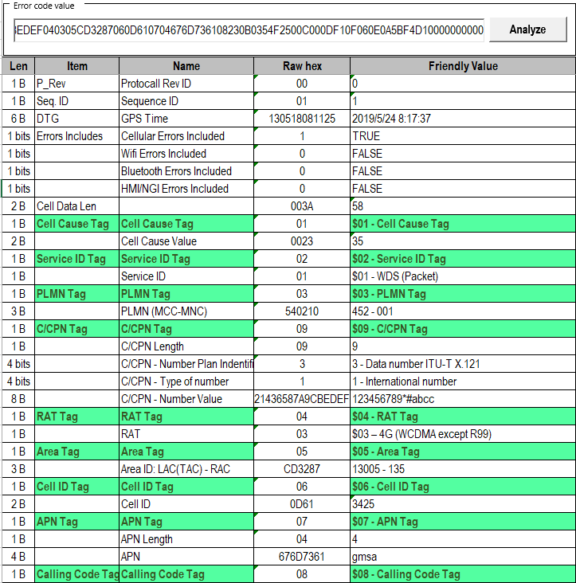
Keep developing Automation tools for work efficiency: Analyse Error Code
Summary
Purpose | Concept | Output | Effectiveness
 |  |  | Frequency | Manual time | Automation time | Remark
Analyse Error code | Error code will be stored whenever appear cellular network issue Input Error code and extract raw data from the code Covert raw data to readable value | VBA script | When have new release | 15 minutes/TCs | 2 minutes/TCs | - Increase productivity for VTM function (total 15 TCs)
Network provider (ex: mobifone)
Extract
Any error from cellular network
Extract data from Error Code
TCP
Store error code
Convert data to readable value
Convert
A. 7 / 10

Slide 11
Keep developing Automation tools for work efficiency: Support management tasks
Summary
Target | Concept | Output | Effectiveness
 |  |  | Frequency | Manual time | Automation time | Remark
Automatically creating report for Test Leader in Excel | Get final test result for items based on result of TCs in each item | VBA script | Weekly | 2 hours | 5 minutes | Project: ICAS3 EU FIT
 | Collect members test result (1 member test 1 or many modules, 1 module tested by 1 or many people) into a file summary. | VBA script | Weekly | 8 hours | 2 hours | Project:GM V2 ST
 |  | VBA script | Weekly | 20 minutes | 5 minutes | Project: BMW Wave
Maintain HR Flexible time calculation and CBL Course Summary | Update when have change request from HR and CBL manager (Ms.Lien) | VBA script | Monthly | - | - | Reduce effort for HR and CBL manager
A. 8 / 10

Slide 12
Automation result Y2019
Module | Total TCs (1) | Total TSs (2) | Coverage (2)/(1) | Total TSs run (3) | Success TS = 3-4 |  | Manual result |  | Successful rate (5/3) | Reliability (%) 6/3 | Remark
 |  |  |  |  | Success (4) | Error (5) | Match (6) | Not match (7)
OTAM | 492 | 252 | 51.2% | 252 | 130 | 122 | 130 | 0 | 51.6% | 100% | Error reason: + Network issue (OCC Cannot receives AIF message from TCP and vice versace) + Scripts not optimized
TNS* | 289 | 99 | 34.3% | 99 | 26 | 73 | 26 | 0 | 26.3% | 100%
COL | 426 | 247 | 58.0% | 247 | 99 | 148 | 99 | 0 | 40.1% | 100%
ADA | 531 | 125 | 23.5% | 125 | 83 | 42 | 83 | 0 | 66.4% | 100%
VTM | 359 | 0 | 0.0% | 0 | 0 | 0 | 0 | 0 | 0.0% | 100%
DIAG | 435 | 108 | 24.8% | 108 | 97 | 11 | 97 | 0 | 89.8% | 100%
CR* | 1385 | 0 | 0.0% | 0 | 0 | 0 | 0 | 0 | 0.0% | 100%
UI | 114 | 0 | 0.0% | 0 | 0 | 0 | 0 | 0 | 0.0% | 100%
FSA | 315 | 0 | 0.0% | 0 | 0 | 0 | 0 | 0 | 0.0% | 100%
VIF | 114 | 0 | 0.0% | 0 | 0 | 0 | 0 | 0 | 0.0% | 100%
Total | 4460 | 831 | 18.6% | 831 | 435 | 396 | 435 | 0 | 52% | 100%
A. 9 / 10

Slide 13
Automation result Y2020
Module | Total TCs (1) | Total TSs (2) | Coverage (2)/(1) | Total TSs run (all regions) (3) | Executed TSs |  |  |  | Match with manual result |  |  |  | Successful rate 4/(4+5) |  | Reliability (%) (6/4) |  | Remark
 |  |  |  |  | v5.05 |  | v5.13 |  | v5.05 |  | v5.13 |  | v5.05 | v5.13 | v5.05 | v5.13
 |  |  |  |  | Success (4) | Error (5) | Success (4) | Error (5) | Matched (6) | Not matched (7) | Matched (6) | Not matched (7)
OTAM | 567 | 167 | 29.5% | 330 | 162 | 5 | 330 | 0 | 162 | 0 | 0 | 0 | 97.0% | 100.0% | 100% | N/A | Run automation and manual in independence
TNS* | 130 | 103 | 79.2% | 209 | 12 | 91 | 203 | 6 | 12 | 0 | 203 | 0 | 11.7% | 97.1% | 100% | 100% | Run automation and manual in parallel
COL | 347 | 195 | 56.2% | 390 | 177 | 18 | 390 | 0 | 177 | 0 | 0 | 0 | 90.8% | 100.0% | 100% | N/A | Run automation and manual in independence
ADA | 583 | 215 | 36.9% | 438 | 199 | 16 | 436 | 2 | 199 | 0 | 0 | 0 | 92.6% | 99.5% | 100% | N/A
VTM | 766 | 119 | 15.5% | 238 | 115 | 4 | 238 | 0 | 115 | 0 | 0 | 0 | 96.6% | 100.0% | 100% | N/A
DIAG | 1220 | 513 | 42.0% | 481 | 505 | 8 | 481 | 0 | 505 | 0 | 0 | 0 | 98.4% | 100.0% | 100% | N/A
CR* | 1150 | 245 | 21.3% | 433 | 225 | 20 | 364 | 69 | 225 | 0 | 364 | 0 | 91.8% | 84.1% | 100% | 100% | Run automation and manual in parallel
UI | 90 | 0 | 0.0% | 0 | 0 | 0 | 0 | 0 | 0 | 0 | 0 | 0 | 0.0% | 0.0% | 100% | N/A | Run automation and manual in independence
FSA | 260 | 0 | 0.0% | 0 | 0 | 0 | 0 | 0 | 0 | 0 | 0 | 0 | 0.0% | 0.0% | 100% | N/A
VIF | 125 | 0 | 0.0% | 0 | 0 | 0 | 0 | 0 | 0 | 0 | 0 | 0 | 0.0% | 0.0% | 100% | N/A
Total | 5238 | 1557 | 30% | 2519 | 1395 | 162 | 2442 | 77 | 1395 | 0 | 567 | 0 | 90% | 97% | 100% | 100% | Error reason: + Requirement changed + Network issue (Cannot camp to any network) + Log file changed
A. 10 / 10

